Slide 1
Hesquiaht Plant Names

Slide 2
Voices: ciiqpiqum Pat Charleson Sr., muḥikʷił Dolores Bayne, t̓ačiy̓upšiił Fran Memnook, šaaxtuuł Philip Lucas, n̓an̓aḥumyis Cecelia Tom, tupaat Julia Lucas, čiisma Patti Frank, ʔaniicn̓aas JC Lucas. Tech: chuutsqa L. Rorick

Slide 3
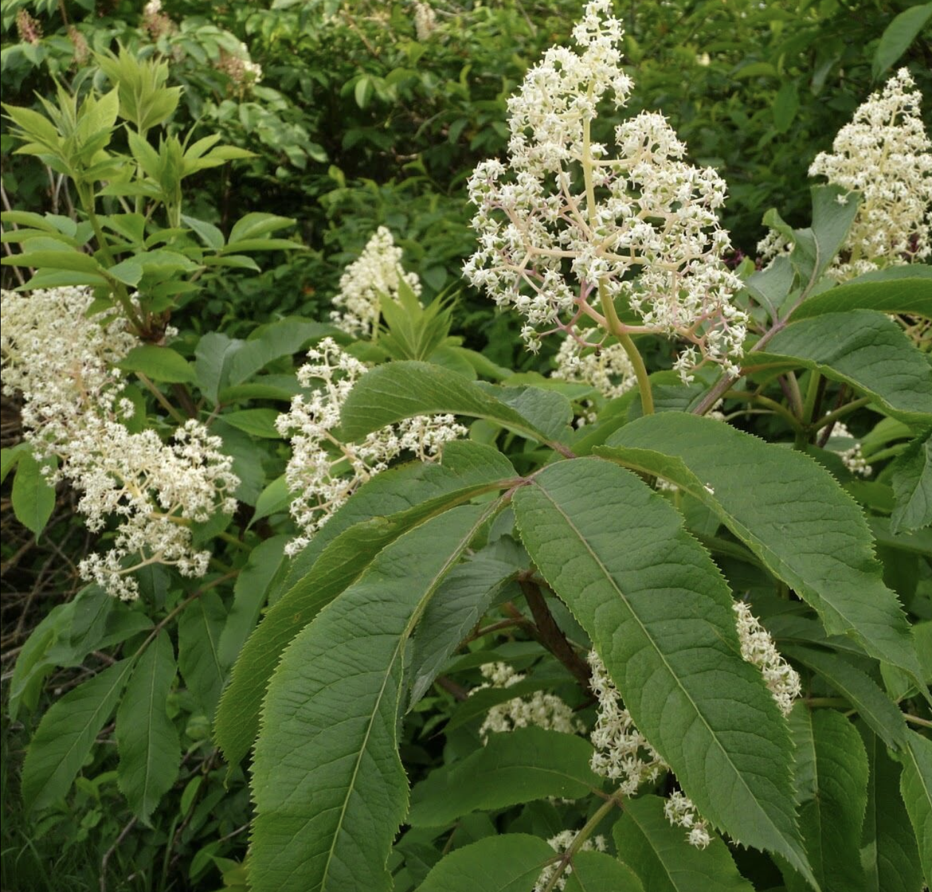
Hesquiaht Plant Name English Plant Name
Plant Pic
Hover and click below for audio

Slide 4
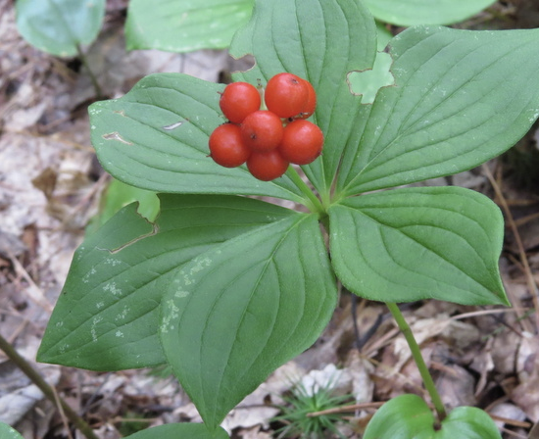
hast̓aači Bunchberry/ Dwarf Dogwood Berry

Slide 5
c̓iwiipt Elderberry Tree

Slide 6
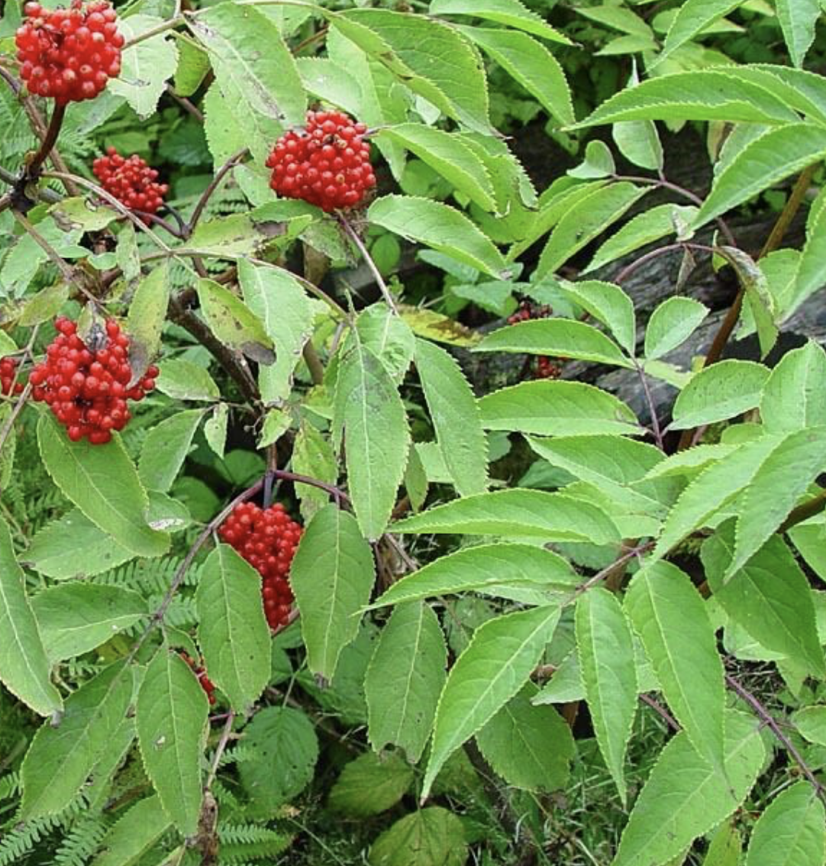
ciiyin Red Elderberry Fruit

Slide 7
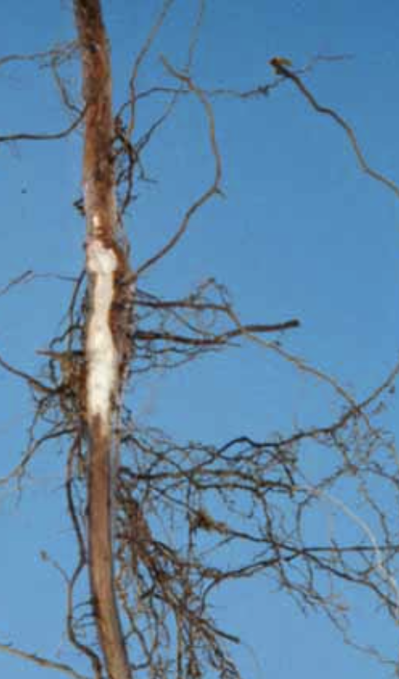
c̓iwiipt mułmumcuk Elderberry Roots

Slide 8
hast̓aači Bunchberry/ Dwarf Dogwood

